Slide 1
KEY STORAGE
BY AQSA EHSAN

Slide 2
KEY STORAGE
Definition:
KV Storage — Definition
NoSQL data model that stores data as pairs: a unique key and its value.
Access pattern: “give key → get value” (dictionary-like), optimized for very fast reads/writes.
Minimal querying (no joins/complex filters); focuses on speed and simplicity.
Example product:1001:title → "Blue Cotton Shirt" product:1001:price → 1999

Slide 3
KV Storage — Core Features
Speed: near O(1) lookups; low latency.
Simplicity: GET/SET/DEL, atomic counters (INCR/DECR).
TTL/Expiry: auto-remove stale data (sessions, cache).
Data structures (tool-dependent): strings, hashes, lists, sets, sorted sets, streams.
Scalability: sharding/partitioning; replicas for HA.
Persistence options: in-memory primary with optional on-disk snapshots/logs.

Slide 4
KV Storage Tools — Overview
Redis: in-memory KV with rich data structures, TTL, pub/sub, streams; optional persistence.
Amazon DynamoDB: fully managed serverless KV/NoSQL on AWS; high scale, TTL, streams.
Memcached: simple distributed cache (volatile; no persistence, limited types).
RocksDB/LevelDB: embedded KV engines inside applications (on-disk, very fast).
Couchbase/Aerospike/Riak: distributed KV/NoSQL databases with clustering.

Slide 5
Redis-Use cases
• Caching (product details / user profiles)
Keep frequently-read data in memory with a short TTL to avoid slow DB calls.
Example: SETEX product:123 300 '{"id":123,"price":1499}' (cache for 5 min)
• Sessions & tokens (login state)
Store a user’s session/token with expiry so logins auto-expire.
Example: SETEX session:abc123 3600 "user:42" (valid for 1 hour)
• Rate limiting & counters (API quotas, page views)
Count events in a time window and block when the limit is hit.
Example:
INCR user:42:rl:2025-10-01T22:34 → EXPIRE user:42:rl:2025-10-01T22:34 60
(per-minute counter; if value > N, throttle)
• Leaderboards / real-time metrics (sorted sets)
Maintain ranked lists by a numeric score using Sorted Sets.
Example: ZADD quiz:leaderboard 980 "user:42" → ZREVRANGE quiz:leaderboard 0 9 WITHSCORES
• Feature flags (on/off toggles)
Flip features per app/env or per user for gradual rollout.
Example: SET feature:new_checkout "on" or HSET flags:env:prod new_checkout on

Slide 6
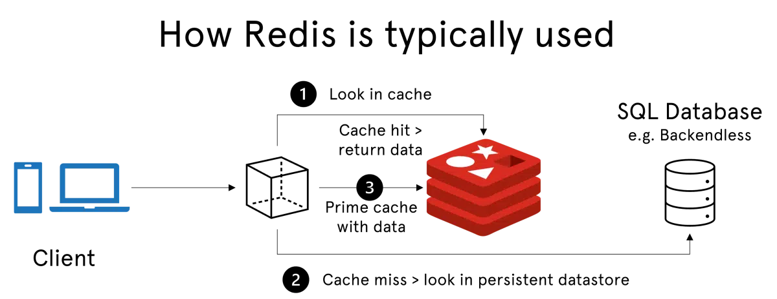
How Redis is Typically used

Slide 7
CASE STUDY Timed Quiz — Students & Leaderboard
Problem statement
You’re running a 30-minute quiz. Each student has a profile, and every correct answer adds points to their score. We need to:
store student profiles,
track the quiz window (start/end),
accept submissions (rate-limited),
update the leaderboard,
read current standings,
fix profile details if needed,
and delete records at the end.
We’ll use only core Redis data types (Strings, Hashes, Sorted Sets) so it works on any Redis Cloud plan and in Redis Insight.
Key design (namespaced)
quiz:student:<id> — Hash (student profile: name, dept)quiz:leaderboard
Sorted Set (member = student id, score = points)quiz:ends_at
String (unix timestamp; also used for TTL checks)quiz:rate:<id>:<unix_min>
String (submission rate-limit counter per minute)

Slide 8
CASE STUDY Timed Quiz — Students & Leaderboard
What you’ll be able to show
SET/GET: set quiz end time, get it; rate-limit counters.
UPDATE: ZINCRBY to add score; HSET to update student data.
DELETE: DEL a profile; ZREM from leaderboard; cleanup keys.
Seed sample data
HSET quiz:student:101 name "Aqsa" dept "CS“
HSET quiz:student:102 name "Bilal" dept "SE“
HSET quiz:student:103 name "Daniyal" dept "AI“
ZADD quiz:leaderboard 0 101 0 102 0 103
SET quiz:ends_at {UNIXTIME} EX 3600
Read (GET) scenarios
GET quiz:ends_at
HGETALL quiz:student:101
ZRANGE quiz:leaderboard 0 -1 WITHSCORES
ZREVRANGE quiz:leaderboard 0 -1 WITHSCORES

Slide 9
CASE STUDY Timed Quiz — Students & Leaderboard
Update (scores & profiles)
ZINCRBY quiz:leaderboard 5 101 # Aqsa +5 points
ZINCRBY quiz:leaderboard 3 102 # Bilal +3 points
ZINCRBY quiz:leaderboard 7 103 # Daniyal +7 points
ZREVRANGE quiz:leaderboard 0 2 WITHSCORES # Top 3HSET quiz:student:102 dept "CS" # Fix dept for Bilal
HGETALL quiz:student:102
Delete scenarios (cleanup)
HDEL quiz:student:103 dept # remove a single field from the hash
ZREM quiz:leaderboard 103 # remove Daniyal from the board
DEL quiz:student:103 # delete the profile key
EXISTS quiz:student:103
ZREVRANGE quiz:leaderboard 0 -1 WITHSCORES

Slide 10
ANY QUESTIONS ?

